Slide 1

“Brain Tumor Detection Using Deep Learning”
Department Of Computer Science and Engineering Jawaharlal Darda Institute of Engineering & Technology, Yavatmal, (M.S), India-445001 Session 2023-2024
Presented by :
Mr. Chetan A. Muneshwar
Mr. Raunak J. Pipariya
Mrs. Shreya N. Nathile
Mr. Amit S. Khandare
Guided by :
Prof. M. K. Popat

Slide 2
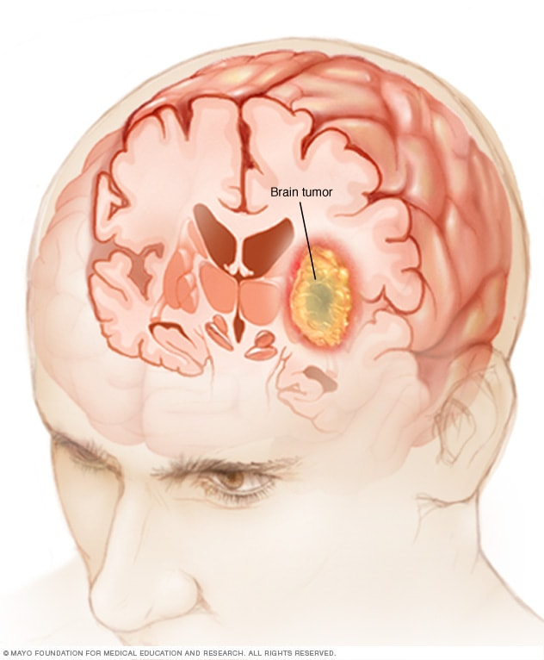
CONTENT:
Abstract
Objective
Research Methodology
Data Flow Diagram
Flowchart
Model Representation
Conclusion
References

Slide 3
ABSTRACT:
Brain tumor detection is a critical aspect of modern healthcare, as early diagnosis and accurate localization are vital for effective treatment and patient outcomes. Deep learning techniques have shown remarkable potential in addressing this challenge. This study presents a novel approach for brain tumor detection using deep learning mechanism.
We employ a convolutional neural network (CNN) architecture that is tailored to analyze medical images, specifically magnetic resonance imaging (MRI) scans. The model is trained on a large dataset of annotated MRI images, enabling it to learn intricate patterns and features indicative of brain tumors. The CNN's multi-layered structure enables it to automatically extract relevant features, minimizing the need for handcrafted feature engineering.
Results demonstrate the effectiveness of the proposed approach, achieving high accuracy and sensitivity in brain tumor detection. This approach not only aids in early diagnosis but also offers the potential for real-time detection and localization, contributing to improved treatment planning. The use of deep learning in brain tumor detection holds promise for enhancing healthcare outcomes and reducing the burden on radiologists, paving the way for more efficient and accurate diagnosis and treatment of brain tumors.
Keywords: Brain tumor detection, Deep learning, Convolutional neural network (CNN), Medical images, Healthcare, Magnetic resonance imaging (MRI)

Slide 4
OBJECTIVE:
Brain tumor at early stage is very difficult task for doctors to identify.
MRI images are more prone to noise and other environmental interference.
So, it becomes difficult for doctors to identify tumor and their causes.
So here we come up with the system, where system will detect brain tumor from images.

Slide 5
RESEARCH METHODOLOGY:
The system will have mainly five modules.
Dataset: In dataset we can take multiple MRI images and take one as input image
Pre-processing: In pre-processing image to encoded the label and resize the image.
Split the data: In split the data we set the image as Training Data and Testing Data.
Build CNN model: To train Deep Neural network for classification.
Classification: Used to classify the Brain tumor

Slide 6
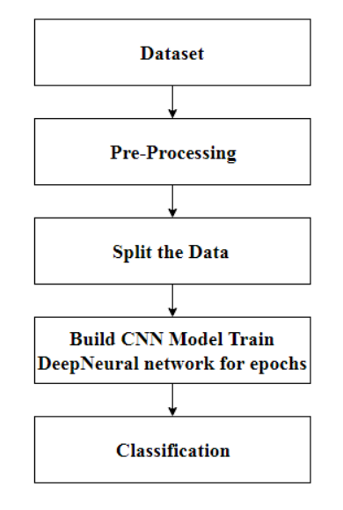
Data Flow Diagram:
START
END

Slide 7
Flowchart:
Start
Input MRI Image from dataset
Image Preprocessing
CNN feature Extraction + Classification
If Tumor is detected
?
NO
YES
Preprocessing
Normal
Segmentation
Area of classification of brain tumor
Glioma
Meningioma
Output
Pituitary

Slide 8
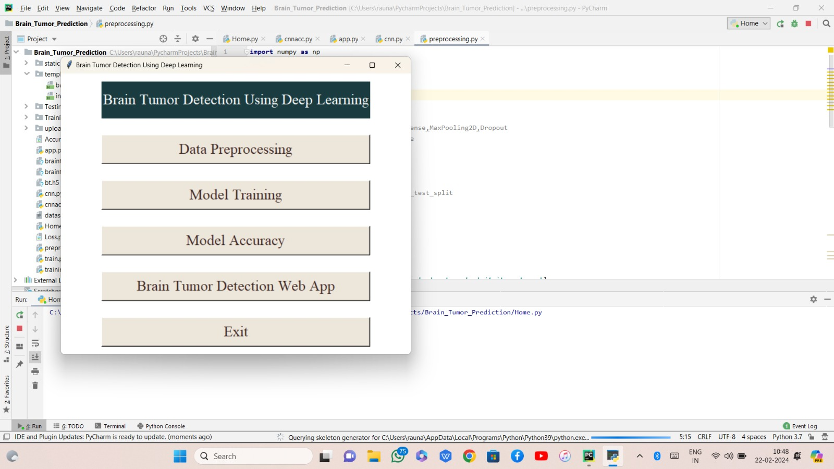
MODEL REPRESENTATION

Slide 9
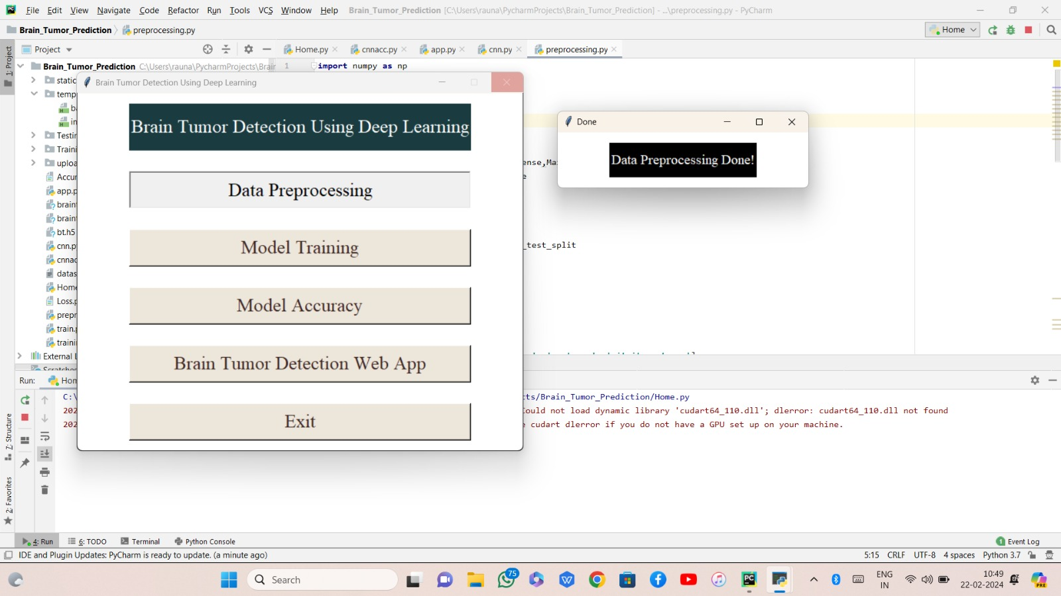

Slide 10
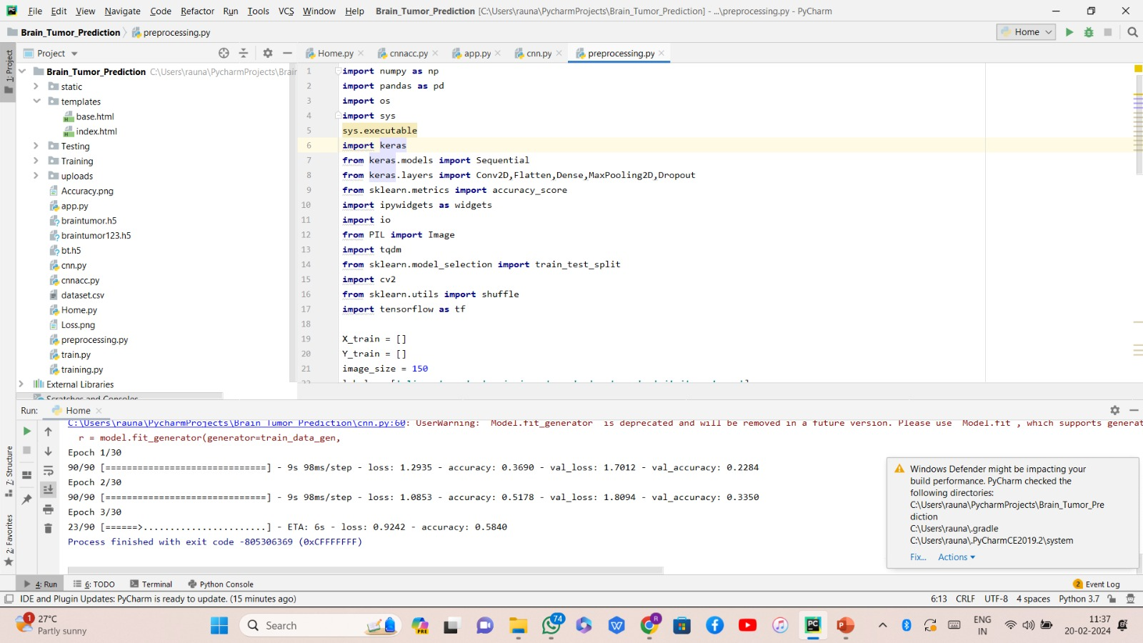

Slide 11
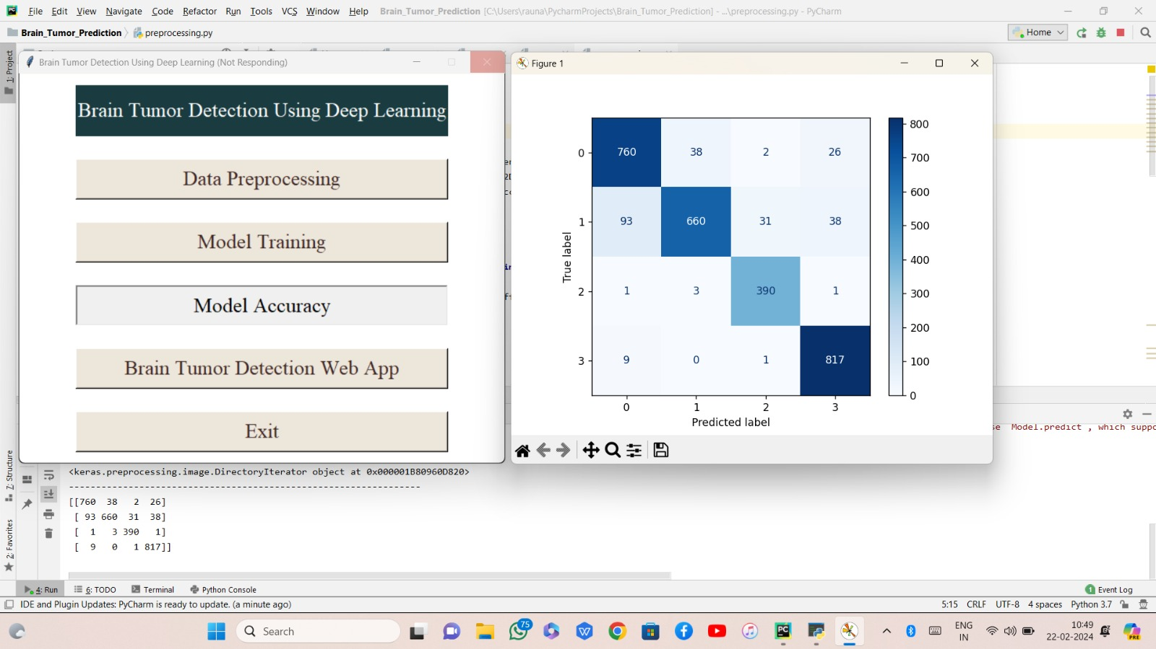

Slide 12
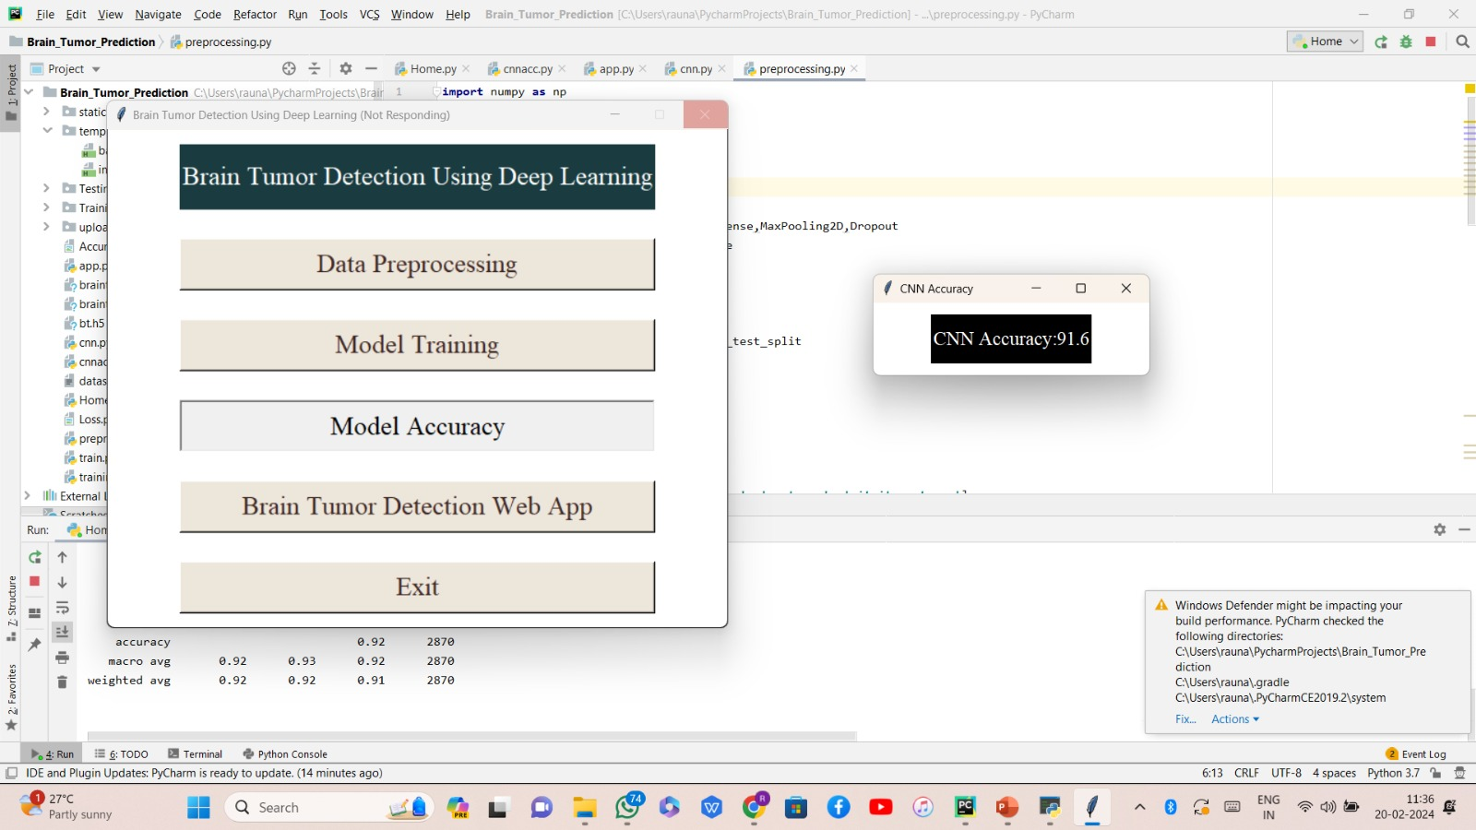
Derived Accuracy:

Slide 13
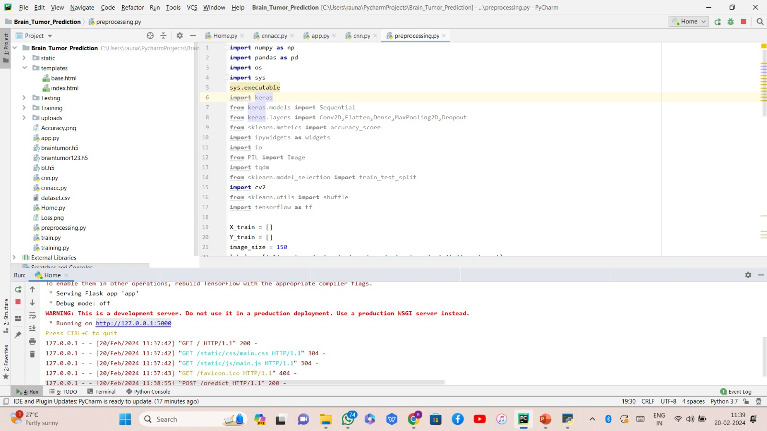
8+
Website link Activation

Slide 14
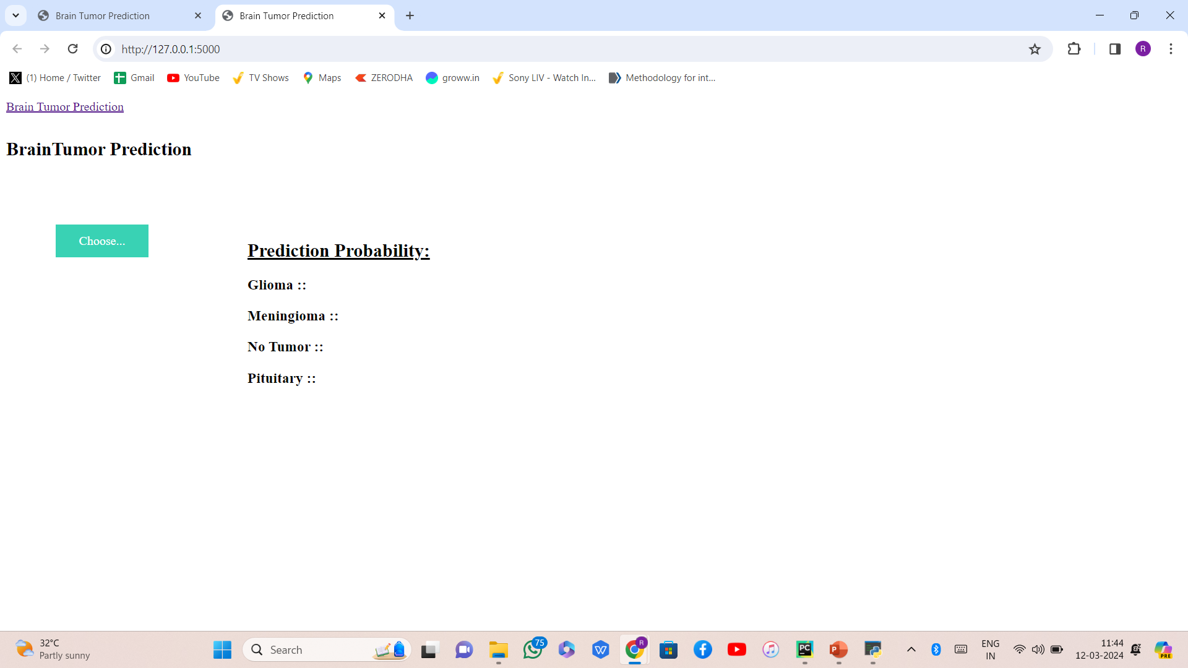

Slide 15
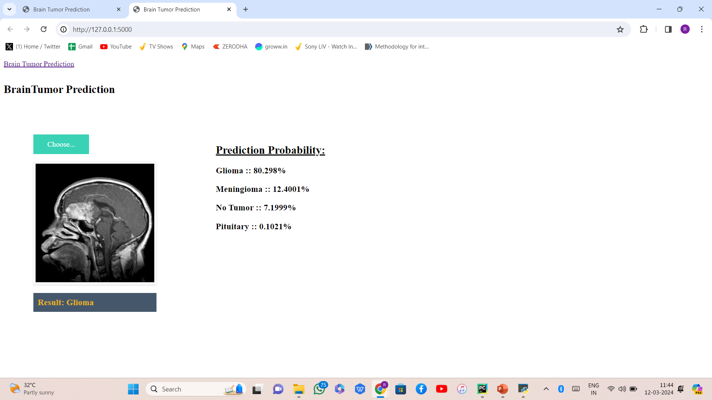

Slide 16
CONCLUSION:
In our study, we utilized a dataset of Brain MRI images and applied four Convolutional Neural Network (CNN) models for the task of classifying the scans into four different classes: Glioma, Meningioma, No tumor, and Pituitary. The purpose was to evaluate the performance of these models in accurately identifying brain tumor.

Slide 17
REFERENCES:
Minu Samantaray, Millee Panigrahi, K.C. Patra, Avipsa S. Panda, Rina Mahakud “An adaptive filtering technique for brain tumor analysis and detection” 2016 10th International Conference on Intelligent Systems and Control (ISCO)
2. Sneha Grampurohit, Venkamma Shalavadi, Vaishnavi R. Dhotargavi, Megha Kudari, Mrs Soumya Jolad “BRAIN TUMOR DETECTION USING DEEP LEARNING MODELS” 2020 IEEE India Council International Subsections Conference (INDISCON)
3. Avigyan Sinha, Aneesh R P, Malavika Suresh, Nitha Mohan R, Abinaya D, Ashwin G Singerji “Brain Tumor Detection Using Deep Learning” 2021 Seventh International conference on Bio Signals, Images, and Instrumentation (ICBSII)
4. S. Pereira, A. Pinto, V. Alves, C.A. Silva. (2016). “Brain tumor segmentation using convolutional neural networks in MRI images”, IEEE transactions on medicalimaging,pp.1240-1251, 2016. https://doi.org/10.1109/TMI.2016.2538465.
5. X.W. Gao, R. Hui, Z. Tian. (J2017). “Classification of CT brain images based on deep learning networks, Computer methods and programs in biomedicine”,pp.49-56,Jan2017. https://doi.org/10.1016/j.cmpb.2016.10.007.

Slide 18
ANY QUESTIONS !!!

